Slide 1
Date Fruit Image Classifier
AbdulrahamAn almyman (@PYTHON01100100)
Khaled almadi

Slide 2
Content
Introduction
Problem Description
Dataset
Methodology
Results
Challenges
Conclusion

Slide 3
Introduction
This project is an implementation to machine learning algorithms to build a model that can predict the type of the date fruit.
Roles
Abdulrahman: Building the model.
Khaled: Observing the process and writing the report and presentation.

Slide 4
Problem Description
We need to identify the type of fruit present in an image. By recognizing visual patterns, such as color, shape, and texture, associated with different fruit varieties.
Applications
Agriculture: automate the harvesting process.
Retail and E-Commerce: identify and categorize fruits in grocery stores and online marketplaces.
Education: Learning tools will enable people to learn the difference between date types

Slide 5
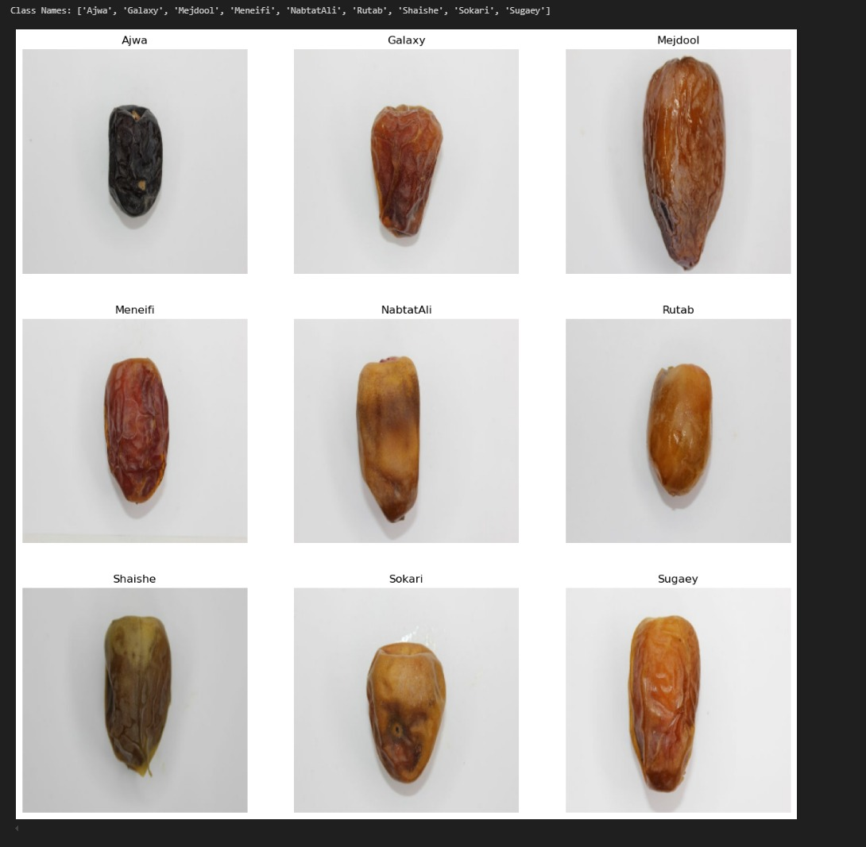
Dataset
The dataset contains 9 different types of the date fruit.

Slide 6
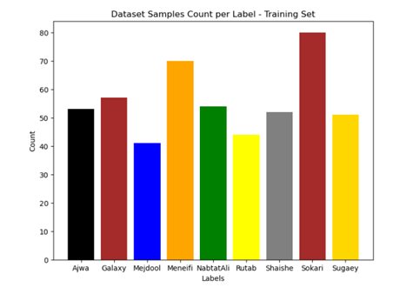
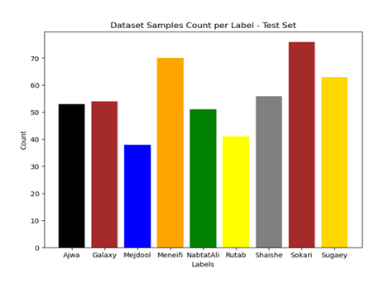
Dataset Samples Count Per Label Charts
Training Set
Test Set

Slide 7
Data Preprocessing
Rescaling: Pixel values are scaled to the range of 0 to 1 using layers.Rescaling(1./255). This normalization helps to standardize the input data and improve model training.

Slide 8
CNN Architecture
Conv2D Layer 1: Applies 16 filters of size 3x3 with ReLU activation and same padding.
MaxPooling2D Layer 1: Downsamples the feature maps by a factor of 2.
Conv2D Layer 2: Applies 32 filters of size 3x3 with ReLU activation and same padding.
MaxPooling2D Layer 2: Downsamples the feature maps by a factor of 2.
Conv2D Layer 3: Applies 64 filters of size 3x3 with ReLU activation and same padding.
MaxPooling2D Layer 3: Downsamples the feature maps by a factor of 2.

Slide 9
CNN Architecture
Input Layer: Receives input images of size 250x250x3.
Flatten Layer: Flattens the output of the convolutional layers into a 1D vector.
Dense Layer 1: Fully connected layer with 128 units and ReLU activation.
Output Layer: Fully connected layer with the number of units equal to the number of classes, using softmax activation for multi-class classification.

Slide 10
Optimizer
Used Adam optimizer with the default hyperparameters.
Number of Epochs
15 epochs

Slide 11
plots of loss and accuracy on the training and validation sets per epoch

Slide 12
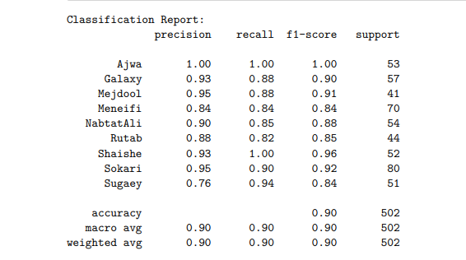
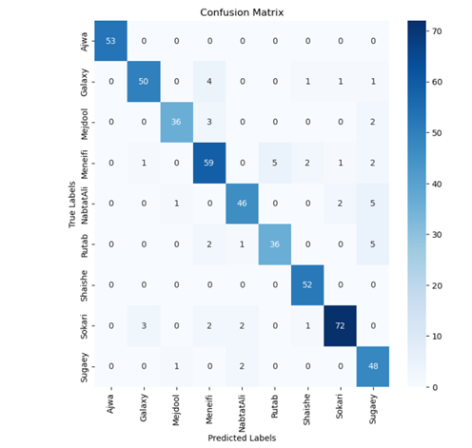
Results
Classification report
CONFUSION MATRIX

Slide 13
Model Performance
The model gained 90% accuracy.
No overfitting
Training time is acceptable
Can be improved

Slide 14
Challenges
The training was taking a lot of time, we solved it by using the GPU to train the model.

Slide 15
Any Questions ?

Slide 16
Thank You

